Slide 1

MIS 547
Cloud Computing

Slide 2

Admin
Assignment 11 due Sunday December 1
03
Quiz 10 Opens today, Due Sunday November 17
02
Assignment 10 Due Sunday November 24
01
Mid-semester project updates grades in D2L
04

Slide 3
Lecture 21: MLOps Day 2

Slide 4
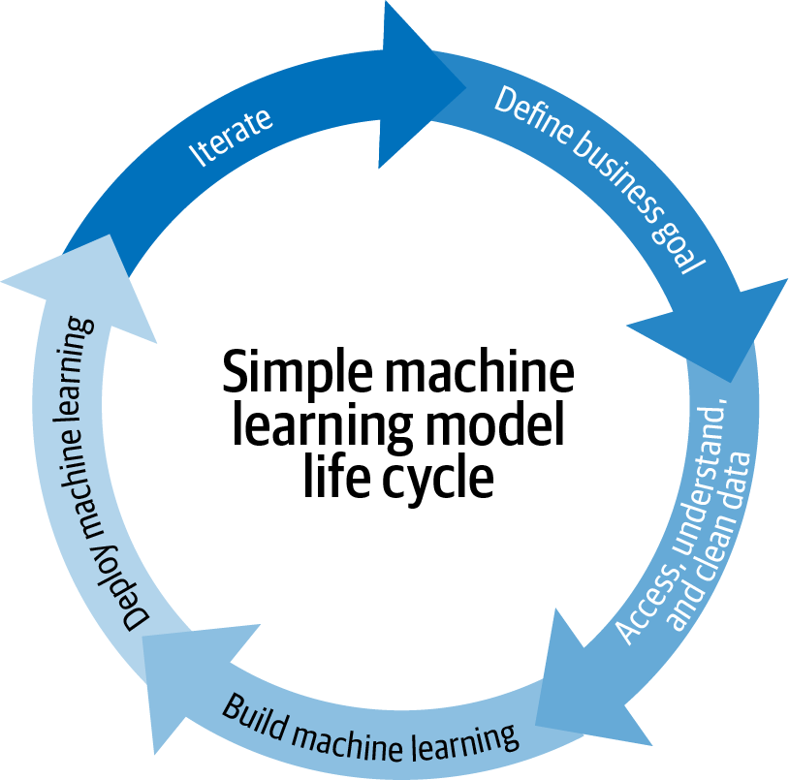
MLOps
Recall: MLOps is the standardization and streamlining of machine learning life cycle management
Source: Introducing MLOps

Slide 5
MLOPs Challenges
Deploying software code into production is fundamentally different than deploying machine learning models into production.
Data is always changing
Model availability
Model quality, accuracy, fairness
Specialized talent
ML modeling relies almost entirely on open source

Slide 6
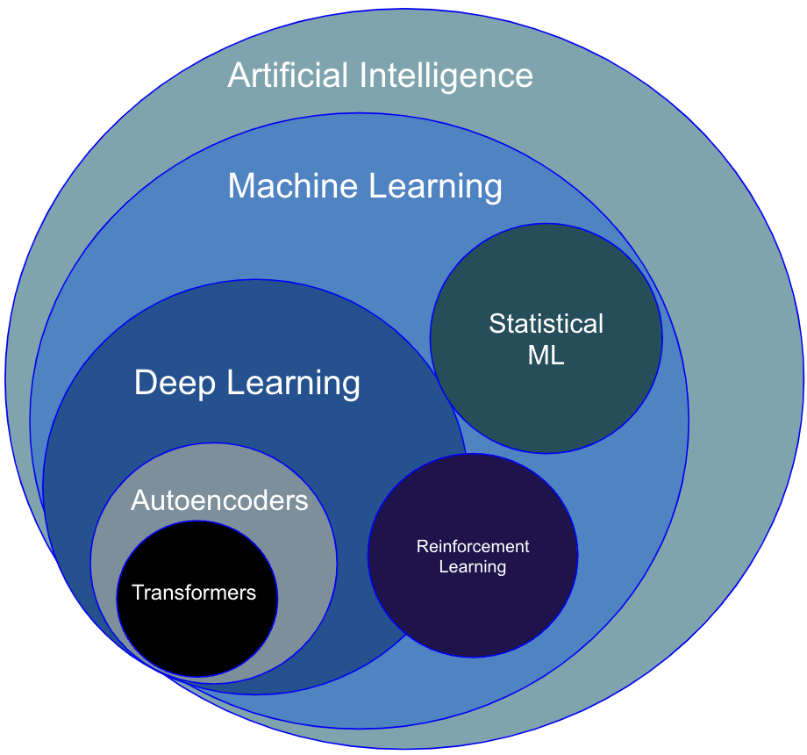
Machine Learning/AI Model Families
Each AI/ML domain or family has unique considerations and implications for production.
For example, generative language models have infrastructure requirements for Retrieval Augmented Generation (RAG) that statistical models do not have.
We are going to cover the most generic approaches we can; but keep in mind that your MLOps architecture and infrastructure will have to be specified according to the task and data you’re using!

Slide 7
Key Steps in Implementing ML
Model Development
Prepare for production
Data pipelines
Model training
Model deployment
Model inference
Serving outputs/ system actions
Monitoring and retraining

Slide 8
Recall: ML Lifecycle
This lecture discusses tooling and approaches for these steps
Research Question
Data Collection & Preprocessing
Experimentation & Evaluation
Model Deployment
Model Serving & Inference
Monitoring & Maintenance
Cleaning, feature engineering
Experimentation, evaluation, hyperparameter tuning, etc.
Persist model weights
Streaming/ online data
Batch data
Ongoing evaluation

Slide 9
MLOps: Data Collection & Preprocessing
Data Ingestion Tooling
Fivetran
Singer
Stitch
Airbyte
Research Question
Data Collection & Preprocessing
Experimentation & Evaluation
Model Deployment
Model Serving & Inference
Monitoring & Maintenance

Slide 10
MLOps: Data Collection & Preprocessing
Streaming Data Ingestion Tooling
Kafka
Amazon Kinesis
Google Pub/Sub
Apache Spark
Research Question
Data Collection & Preprocessing
Experimentation & Evaluation
Model Deployment
Model Serving & Inference
Monitoring & Maintenance

Slide 11
MLOps: Data Collection & Preprocessing
Data Orchestration & Transformation
dbt
Dataform (Google Cloud)
Microsoft SQL Server Integration Services (SSIS)
Custom code
Airflow
Research Question
Data Collection & Preprocessing
Experimentation & Evaluation
Model Deployment
Model Serving & Inference
Monitoring & Maintenance

Slide 12
MLOps: Data Collection & Preprocessing
Data Storage
Snowflake
Amazon Redshift
S3
Databricks
BigQuery
Research Question
Data Collection & Preprocessing
Experimentation & Evaluation
Model Deployment
Model Serving & Inference
Monitoring & Maintenance

Slide 13
MLOps: Experimentation and Evaluation
Key considerations:
Persisting experimental results
Hyperparameters
Data
Model architecture
Collaboration with other engineers
Model registry
ML Infrastructure
PyTorch
TensorFlow
Hugging Face
Deepspeed
MLX
XGBoost
Jax
Research Question
Data Collection & Preprocessing
Experimentation & Evaluation
Model Deployment
Model Serving & Inference
Monitoring & Maintenance

Slide 14
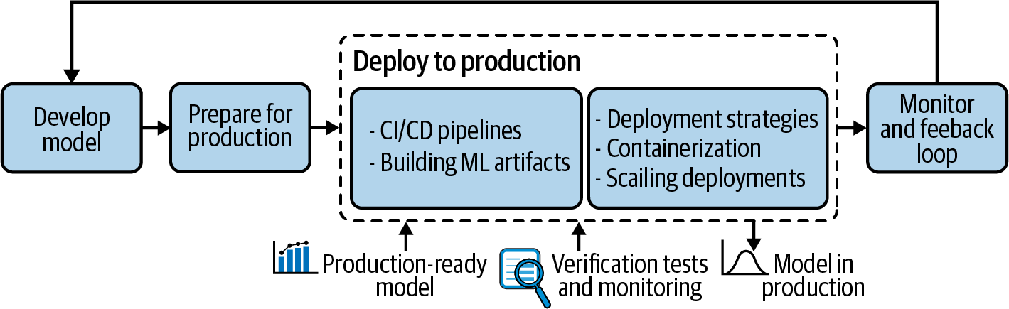
MLOps: Model Deploying models to Production
Research Question
Data Collection & Preprocessing
Experimentation & Evaluation
Model Deployment
Model Serving & Inference
Monitoring & Maintenance

Slide 15
MLOps: CI/CD Pipelines
Use CI/CD to for deploying to production.
Research Question
Data Collection & Preprocessing
Experimentation & Evaluation
Model Deployment
Model Serving & Inference
Monitoring & Maintenance

Slide 16
CI/CD For MLOps
Build the model
Build model artifacts
Send to long-term storage
Run basic checks
Generate explainability reports
Deploy to test environment
Validate model performance, computational performance
Deploy to prod environment

Slide 17
MLOps: Persist model artifacts
Persist model artifacts
Research Question
Data Collection & Preprocessing
Experimentation & Evaluation
Model Deployment
Model Serving & Inference
Monitoring & Maintenance

Slide 18
ML Model Artifacts
Code for the model and preprocessing
Hyperparameters and configuration
Training and validation data
Trained model in runnable form
Environment including libraries with specific versions, environment variables, etc.
Documentation
Code and data for testing

Slide 19
MLOps: Deployment Strategies
Choose a deployment strategy that makes sense for your environment
Research Question
Data Collection & Preprocessing
Experimentation & Evaluation
Model Deployment
Model Serving & Inference
Monitoring & Maintenance

Slide 20
MLOps: Deployment strategies
Avoid downtime (especially with real-time scoring)
Blue-green deployment
Canary releases
Stable version of model is kept in production, but a certain percentage of workload is redirected to the new model, results are monitored
Often used in A/B testing
Research Question
Data Collection & Preprocessing
Experimentation & Evaluation
Model Deployment
Model Serving & Inference
Monitoring & Maintenance

Slide 21
MLOps: Production Options
One model deployed on one server
One model deployed on multiple servers
Multiple versions of a model deployed on one server
Multiple versions of a model deployed on multiple servers
Multiple versions of multiple models deployed on multiple servers
Research Question
Data Collection & Preprocessing
Experimentation & Evaluation
Model Deployment
Model Serving & Inference
Monitoring & Maintenance

Slide 22
MLOps: Inference
Batch scoring
Whole datasets are processed using a model (daily scheduled jobs)
Real-time scoring
Small number of records are scored, such as when an ad is displayed on a website and a user session is scored by models to decide what to display
Research Question
Data Collection & Preprocessing
Experimentation & Evaluation
Model Deployment
Model Serving & Inference
Monitoring & Maintenance

Slide 23
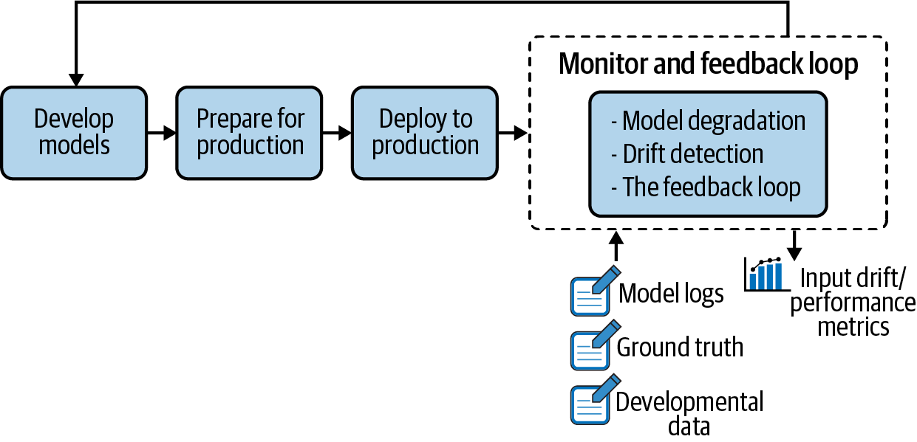
MLOps: Monitoring and Maintenance
Research Question
Data Collection & Preprocessing
Experimentation & Evaluation
Model Deployment
Model Serving & Inference
Monitoring & Maintenance

Slide 24
MLOps: Monitoring and Maintenance
Health check (heartbeats)
ML metrics monitoring
Resource monitoring (CPU, memory, disk, network)
Accuracy, precision, recall, F1
Detect when model is going stale
Research Question
Data Collection & Preprocessing
Experimentation & Evaluation
Model Deployment
Model Serving & Inference
Monitoring & Maintenance

Slide 25
Monitoring and Maintenance
Model inputs
Model outputs
Model metadata
System action (e.g., decision)
Model evaluation store
Research Question
Data Collection & Preprocessing
Experimentation & Evaluation
Model Deployment
Model Serving & Inference
Monitoring & Maintenance

Slide 26
Monitoring and Maintenance
Data visualization, alerting, observability
Looker
Sigma Computing
Tableau
Mode
Power BI
Prometheus
Grafana
Other dashboards
Research Question
Data Collection & Preprocessing
Experimentation & Evaluation
Model Deployment
Model Serving & Inference
Monitoring & Maintenance

Slide 27
ML Pipelines/ Ops Tooling
Data Ingestion
Data Preprocessing
Feature Engineering and Selection
Model Training
Model Evaluation
Model Deployment
Monitoring and Maintenance
Apache Kafka, Amazon Kinesis, dbt, airflow
pandas, NumPy
Scikit-learn, Feature Tools
TensorFlow, PyTorch
Scikit-learn, MLFlow
TensorFlow Serving, TFX, Kubeflow, GoogleML Kit, Sagemaker
Prometheus, Grafana

Slide 28
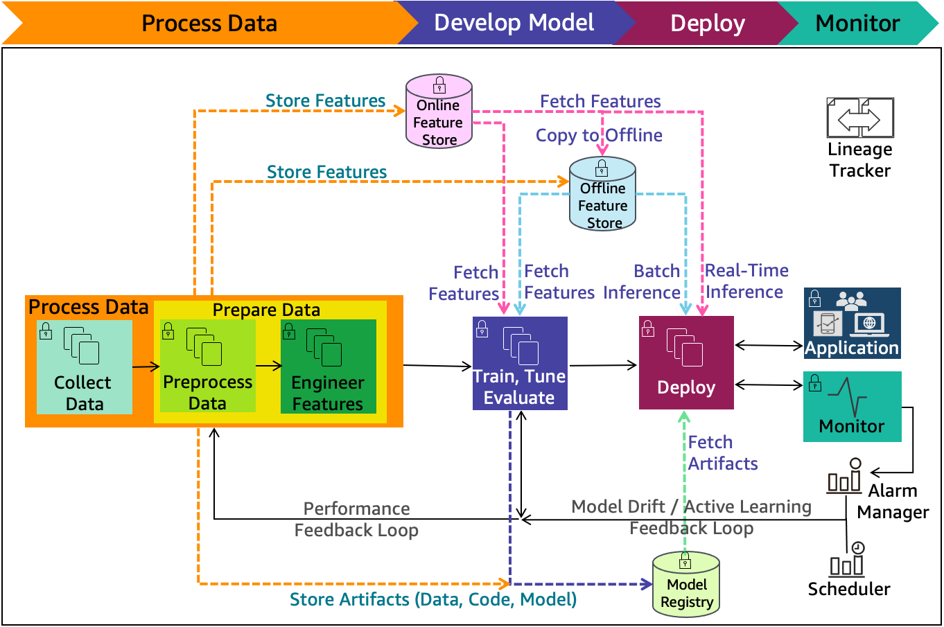
Cloud-Agnostic ML Lifecycle Diagram
Source: https://docs.aws.amazon.com/wellarchitected/latest/machine-learning-lens/ml-lifecycle-architecture-diagram.html

Slide 29
Cloud-Agnostic ML Lifecycle Diagram
Online/Oﬄine feature store
Reduces duplication and the need to rerun feature engineering code across teams and projects. An online store with low-latency retrieval capabilities is ideal for real-time inference. On the other hand, an oﬄine store is designed for maintaining a history of feature values and is suited for training and batch scoring.

Slide 30
Cloud-Agnostic ML Lifecycle Diagram
Model registry
A repository for storing ML model artifacts including trained model and related metadata (such as data, code, and model). It enables the tracking of the lineage of ML models as it can act as a version control system.

Slide 31
Cloud-Agnostic ML Lifecycle Diagram
Performance feedback loop - Informs the iterative data preparation phase based on the evaluation of the model during the model development phase.

Slide 32
Cloud-Agnostic ML Lifecycle Diagram
Model drift feedback loop - Informs the iterative data preparation phase based on the evaluation of the model during the production deployment phase.

Slide 33
Cloud-Agnostic ML Lifecycle Diagram
Alarm manager - Receives alerts from the model monitoring system. It then publishes notifications to the services that can deliver alerts to target applications. The model update re-training pipeline is one such target application.

Slide 34
Cloud-Agnostic ML Lifecycle Diagram
Scheduler - Initiates a model re-training at business-defined intervals.

Slide 35
Cloud-Agnostic ML Lifecycle Diagram
Lineage tracker - Enables reproducible machine learning experiences. It enables the re-creation of the ML environment at a specific point in time, reflecting the versions of all resources and environments at that time.

Slide 36
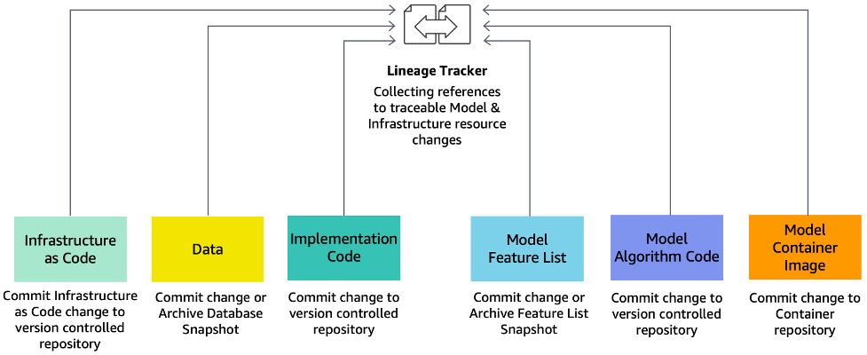
ML Lineage Tracker

Slide 37
ML Lineage Tracker
Infrastructure as code (IaC) - Modeling, provisioning, and managing cloud computing resources (compute, storage, network, and application services) can be automated using infrastructure as code. Cloud computing takes advantage of virtualization to enable the on-demand provisioning of resources. IaC eliminates configuration drift through automation, while increasing the speed and agility of infrastructure deployments. IaC code changes are committed to version-controlled repository.

Slide 38
ML Lineage Tracker
Data - Store data schemes and metadata in version control systems. Store the data in a storage media, such as a data lake. The location or link to the data can be in a configuration file and stored in code version control media.

Slide 39
ML Lineage Tracker
Implementation code - Changes to any implementation code at any point-in-time can be stored in version control media.

Slide 40
ML Lineage Tracker
Model feature list - A “feature store”, discussed earlier in this section (Figure 5), maintains the details of the features as well as their previous versions for any point-in-time changes.

Slide 41
ML Lineage Tracker
Model algorithm code - Changes to any model algorithm code at any point-in-time can be stored in version control media.

Slide 42
ML Lineage Tracker
Model container image - Versions of model container images for any point-in-time changes can be stored in container repositories managed by container registry.

Slide 43
MLOps Architectures

Slide 44
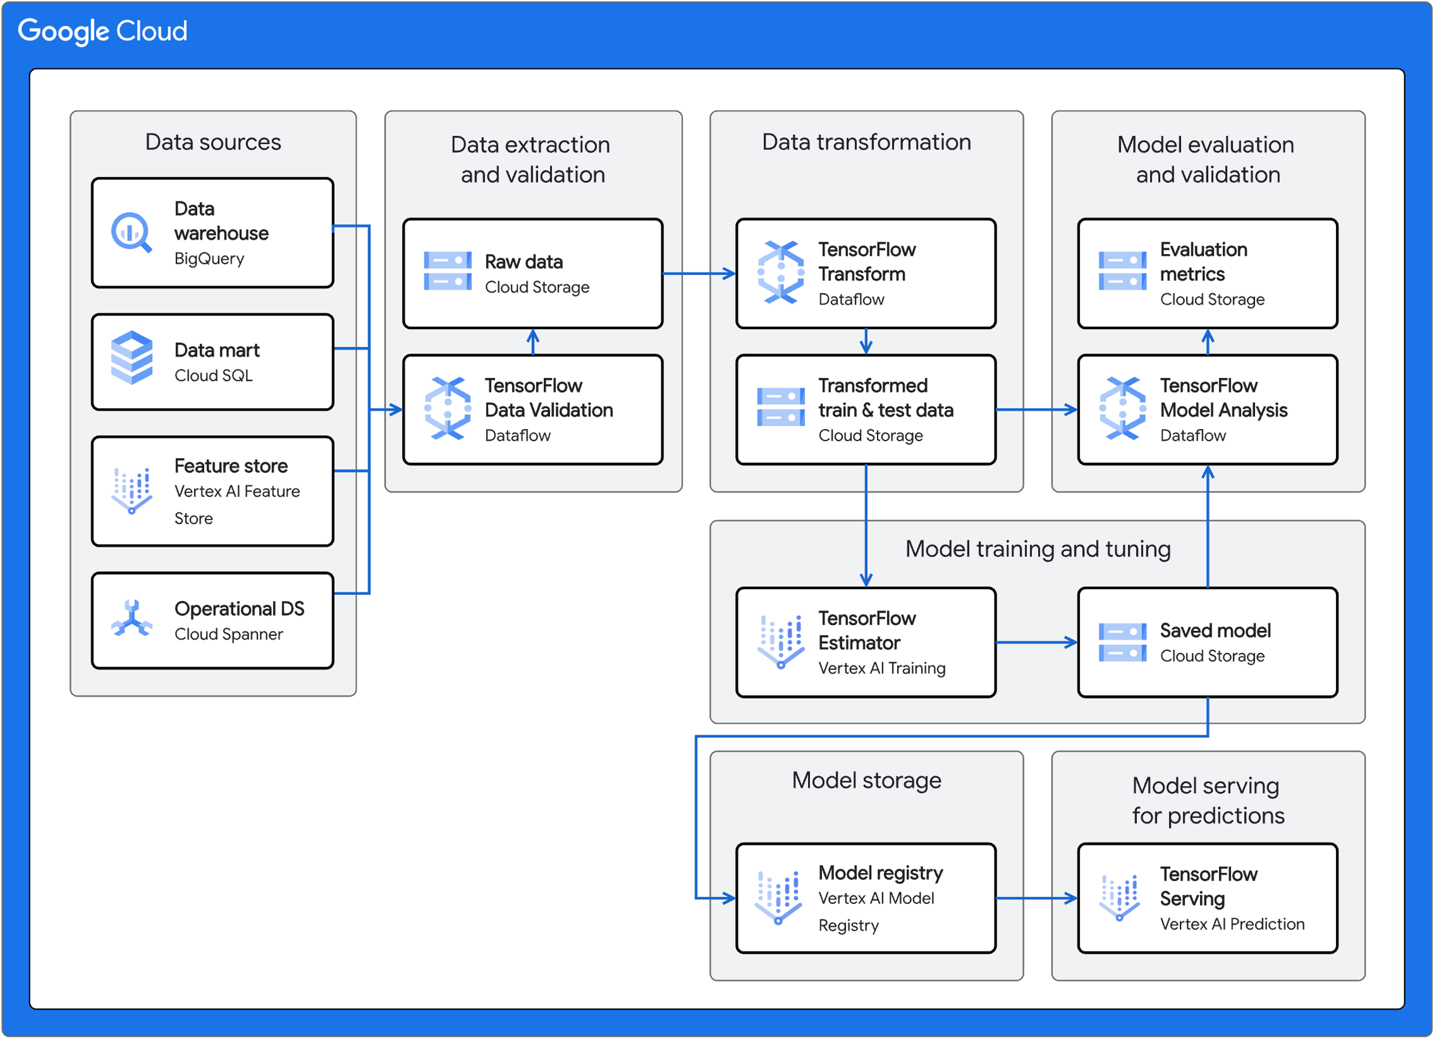
ML Architecture with Google Cloud

Slide 45
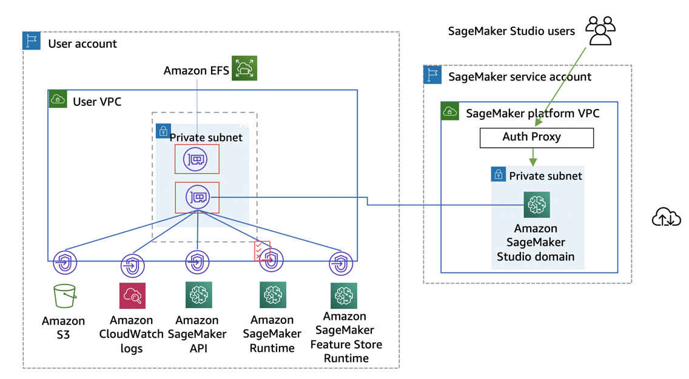
AWS Sagemaker

Slide 46
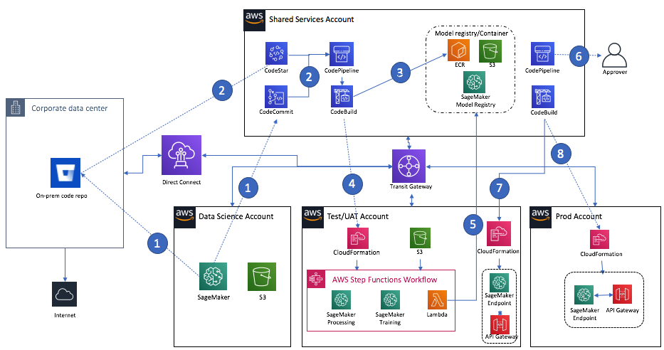
Full process with AWS sagemaker

Slide 47
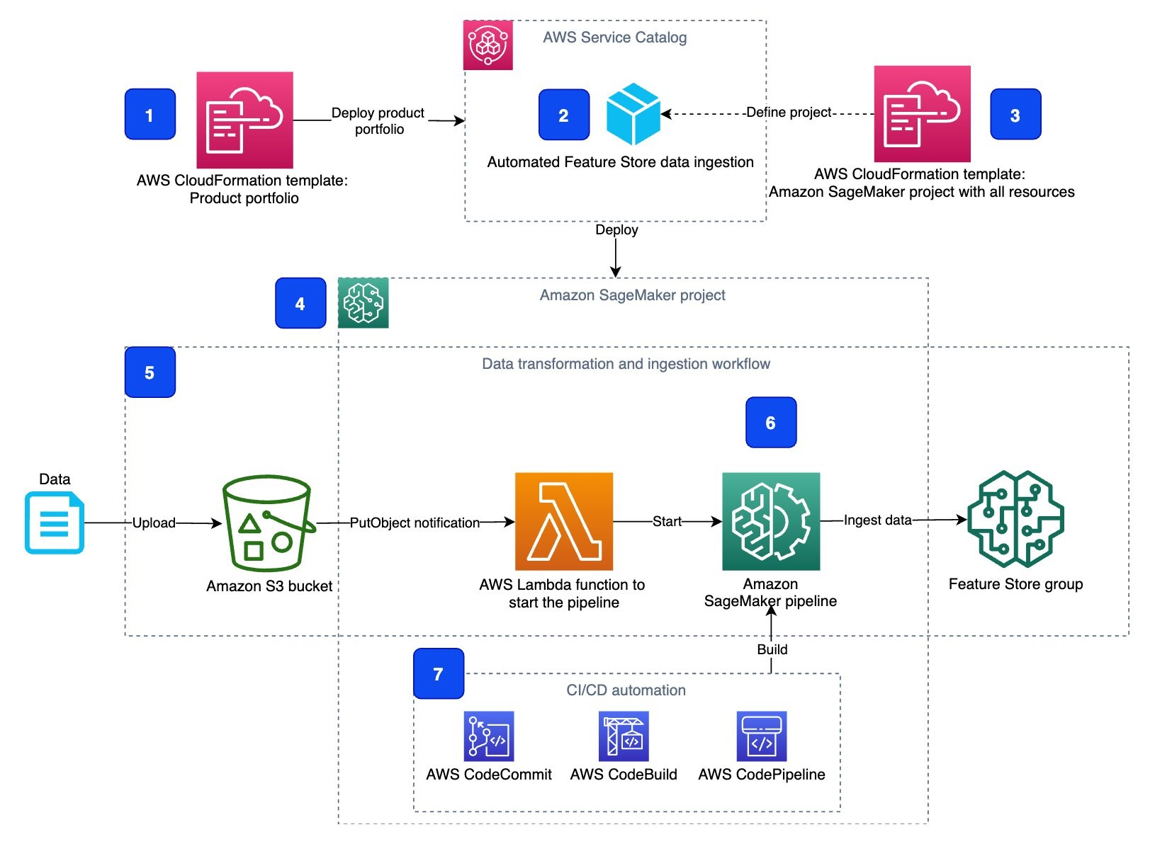
ML Architecture with AWS

Slide 48
AI Infrastructure Landscape
AI Infrastructure Landscape
https://ai-infrastructure.org/ai-infrastructure-landscape/

Slide 49
Well Architected Framework for ML Systems
Well-Architected Pillar | Design Principles for ML Systems
Operational Excellence | – Establish cross-functional teams. – Identify the end-to-end architecture and operational model early in the ML workflow. – Continuously monitor and measure ML workloads. – Establish a model retraining strategy: Automation? Human intervention? – Version machine learning inputs and artifacts. – Automate machine learning deployment pipelines.
Security | – Restrict Access to ML systems. – Ensure Data Governance. – Enforce Data Lineage. – Enforce Regulatory Compliance.
Reliability | – Manage changes to model inputs through automation. – Train once and deploy across environments.
Performance Efficiency | – Optimize compute for your ML workload. – Define latency and network bandwidth performance requirements for your models. – Continuously monitor and measure system performance.
Cost Optimization | – Use managed services to reduce cost of ownership. – Experiment with small datasets. – Right size training and model hosting instances.
Source: AWS and Neptune AI

Slide 50
References
https://learn.microsoft.com/en-us/azure/architecture/ai-ml/guide/mlops-maturity-model

Slide 51
Land Acknowledgement Statement
We respectfully acknowledge the University of Arizona is on the land and territories of Indigenous peoples. Today, Arizona is home to 22 federally-recognized tribes, with Tucson being home to the O’odham and the Yacqui. Committed to diversity and inclusion, the University strives to build sustainable relationships with sovereign Native Nations and Indigenous communities through education offerings, partnerships, and community service.

Slide 52
MLOps Maturity Model
Level | Description | Highlights | Technology
0 | No MLOps | Difficult to manage full machine learning model lifecycle The teams are disparate and releases are painful Most systems exist as "black boxes," little feedback during/post deployment | Manual builds and deployments Manual testing of model and application No centralized tracking of model performance Training of model is manual
1 | DevOps but no MLOps | Releases are less painful than No MLOps, but rely on Data Team for every new model Still limited feedback on how well a model performs in production Difficult to trace/reproduce results | Automated builds Automated tests for application code
2 | Automated Training | Training environment is fully managed and traceable Easy to reproduce model Releases are manual, but low friction | Automated model training Centralized tracking of model training performance Model management
3 | Automated Model Deployment | Releases are low friction and automatic Full traceability from deployment back to original data Entire environment managed: train > test > production | Integrated A/B testing of model performance for deployment Automated tests for all code Centralized tracking of model training performance
4 | Full MLOps Automated Operations | Full system automated and easily monitored Production systems are providing information on how to improve and, in some cases, automatically improve with new models Approaching a zero-downtime system | Automated model training and testing Verbose, centralized metrics from deployed model
Source: Azure Architecture Center

